Slide 1
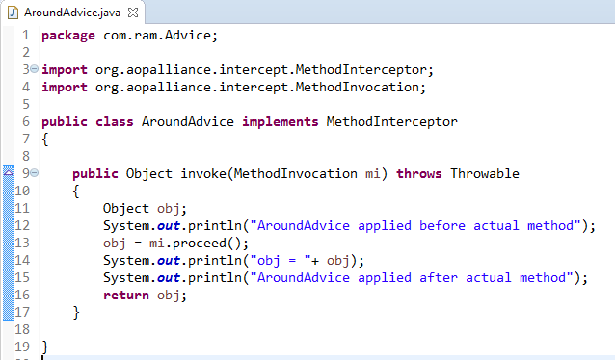
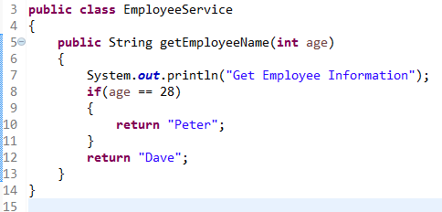
AroundAdvice Example
Around Advice
Around Advice is executed before and after the actual method call.
method
Around Advice
1
3
2

Slide 2
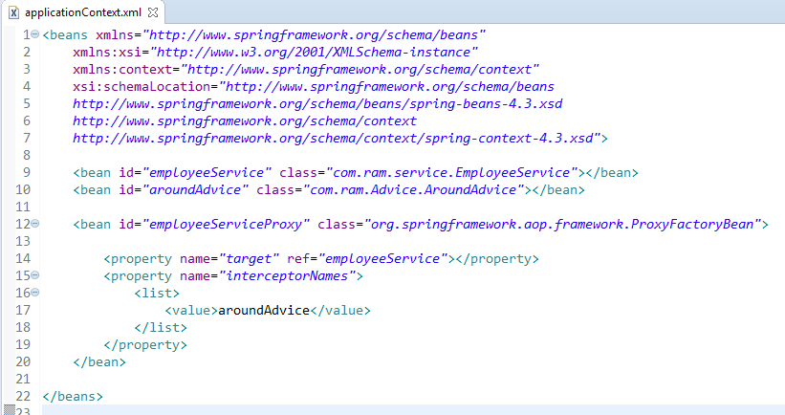
AroundAdvice Example
In xml file, create 3 beans, one for EmployeeService class, second for AroundAdvice class and third for ProxyFactoryBean class.
The ProxyFactoryBean class is provided by Spring Famework. It contains 2 properties target and interceptorNames. The instance of EmployeeService class will be considered as target object and the instance of AroundAdvice class as interceptor.

Slide 3
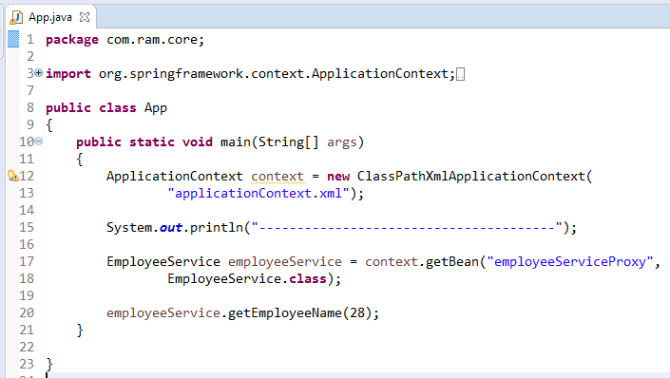
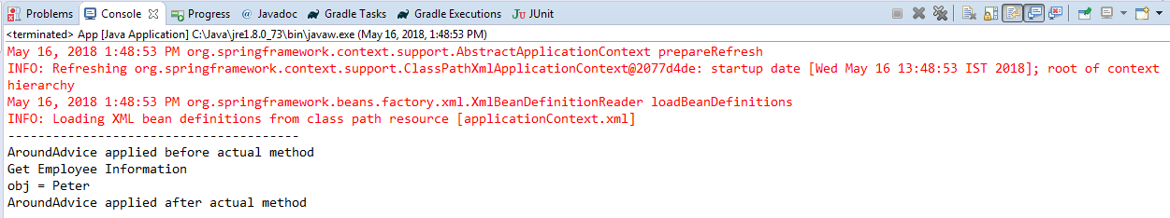
AroundAdvice Example

Slide 4
AroundAdvice Example
Most of the Spring developers are just implements the ‘Around advice ‘, since it can apply all the advice type, but a better practice should choose the most suitable advice type to satisfy the requirements.

